Slide 1

Audio-Visual Emotion
Recognition System

Slide 2

TEAM MEMBERS
Thatikala Srinidhi 22241-cs-001
Ayyerpula Rishi Yadav 22241-cs-002
Maher Khan 22241-cs-004
Ambati Ramakota Reddy 22241-cs-029
Yennam Vani 22241-cs-032
Bondala Charan Tej 22241-cs-038
Hamza Hussain 21241-cs-019
Supervised by :
Mrs.Prathusha (HOD) Mrs.Prashanti (Mentor)

Slide 3
PROJECT SCOPE
OVERVIEW PROJECT PHASSES
PHASE ONE
CONTENTS
audio model
ESTIMATED ANNOUNCE DATES
PHASE TWO
video model
RESULTS
REFRENCES

Slide 4


PROBLEM STATEMENT
Emotion recognition is an important research field for Human-Computer Interaction. Emotion recognition has many applications for examples helping children with autism, helping people who are blind to read facial expressions, helping robots interact more intelligently with people and companies want to improve customer’s experience.
PROJECT SCOPE
Classify emotions neutral, happy, sad, angry and fear, disgust from audio and video.

Slide 5


PHASSES PROJECT
audio phase
video phase

Slide 6
Data Sets used
Data Set | Nature | # Records | Actors | # Emotion | Emotions
RAVDESS (speech , song) | Audio_Visual | 1440 (speech) 1012 (song) 2452 (total) | 24 actors (12 female , 12 male) | 8 (speech) 6 (song) | neutral, calm, happy, sad, angry, fearful, disgust and surprise
SAVEE | Audio_Visual | 480 | 4 actors | 7 | neutral, happy, sad, angry, fearful, diget and surprise

Slide 7
Phase 1
Audio
Audio feature extraction is a necessary step in audio signal processing. There are several ways of extracting features from an audio file such as Mel-frequency cepstral coefficients (MFCC) and Mel spectrograms (Mel Spectrogram) are commonly used in speech recognition and speaker recognition systems. [10]
MFCC, The set of Mel-Frequency Cepstral Coefficients is a cepstral representation of the audio signal obtained based on the Mel-scaled spectrum [11] .The most used MFCCs consists of between 13 to 45 coefficients.
Mel Spectrogram, A spectrogram is an image representation of the waveform signal, it shows its frequency intensity range over time, it can be very useful when evaluating the signal’s frequency distribution over time.

Slide 8
Mel Spectrogram and MFCC

Slide 9
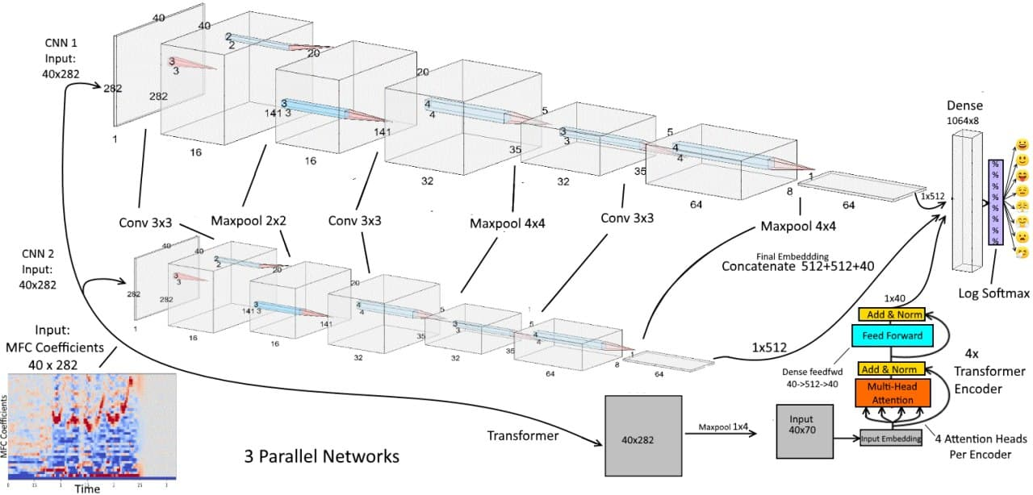
Model Architecture
This is the first original model consisting of 2 parallel CNN with a transformer layer that achieved an accuracy of 75% on RAVDESS dataset.we did add a new layer in 2 parallel CNN
which achieved 75.12% and we make 3 CNN parallel with the transformer layer
we modified augmentation on train dev by white Gaussian noise raise accuracy to 79% and modified at last modification model by stop early raise accuracy 80.86% on RAVDESS dataset

Slide 10
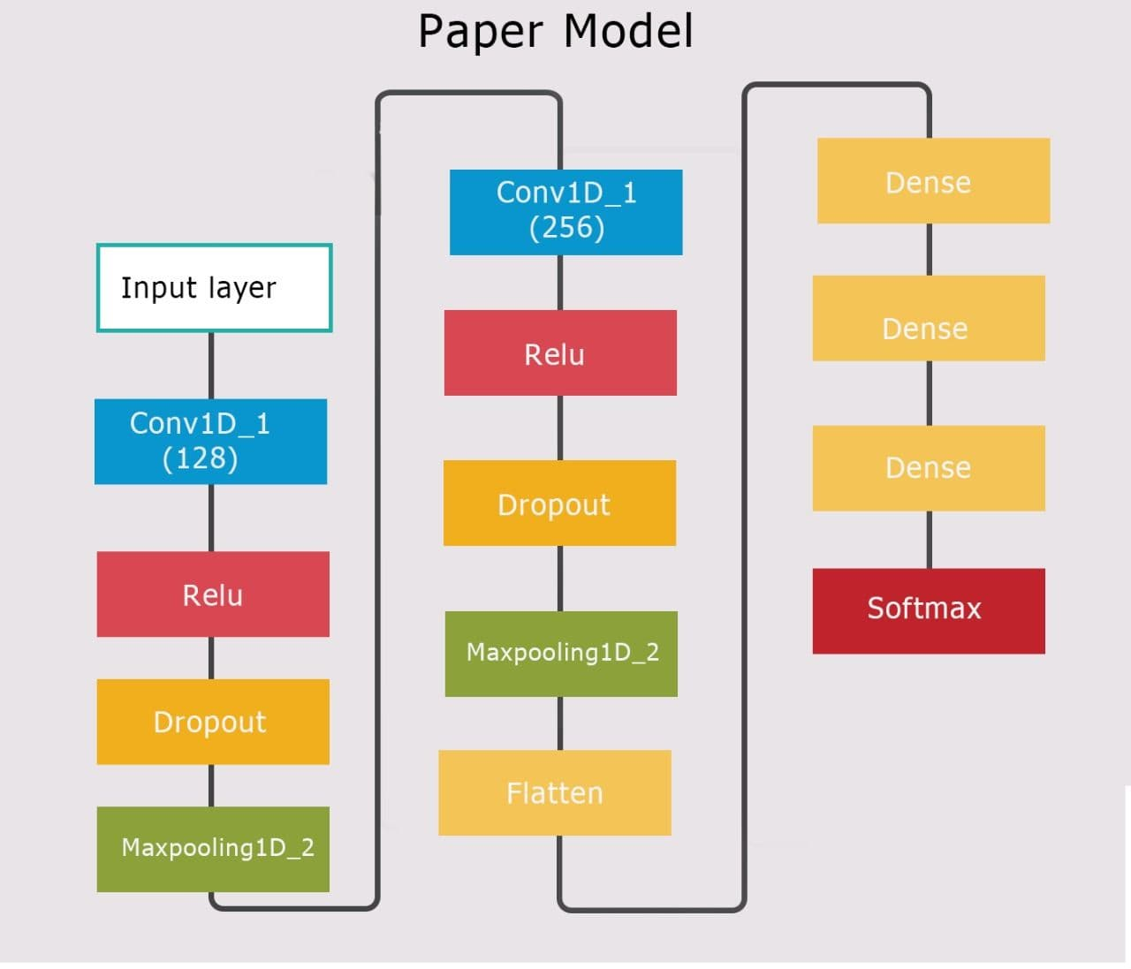
2 parallel CNN with a transformers
The second model consists of 2 Conv layers, used activation function Relu and dropout regularization and falten layer, 3 dense layers and softmax.[1]
Achieved 70.83% accuracy on ravdess dataset and 61.46% on savee dataset.

Slide 11
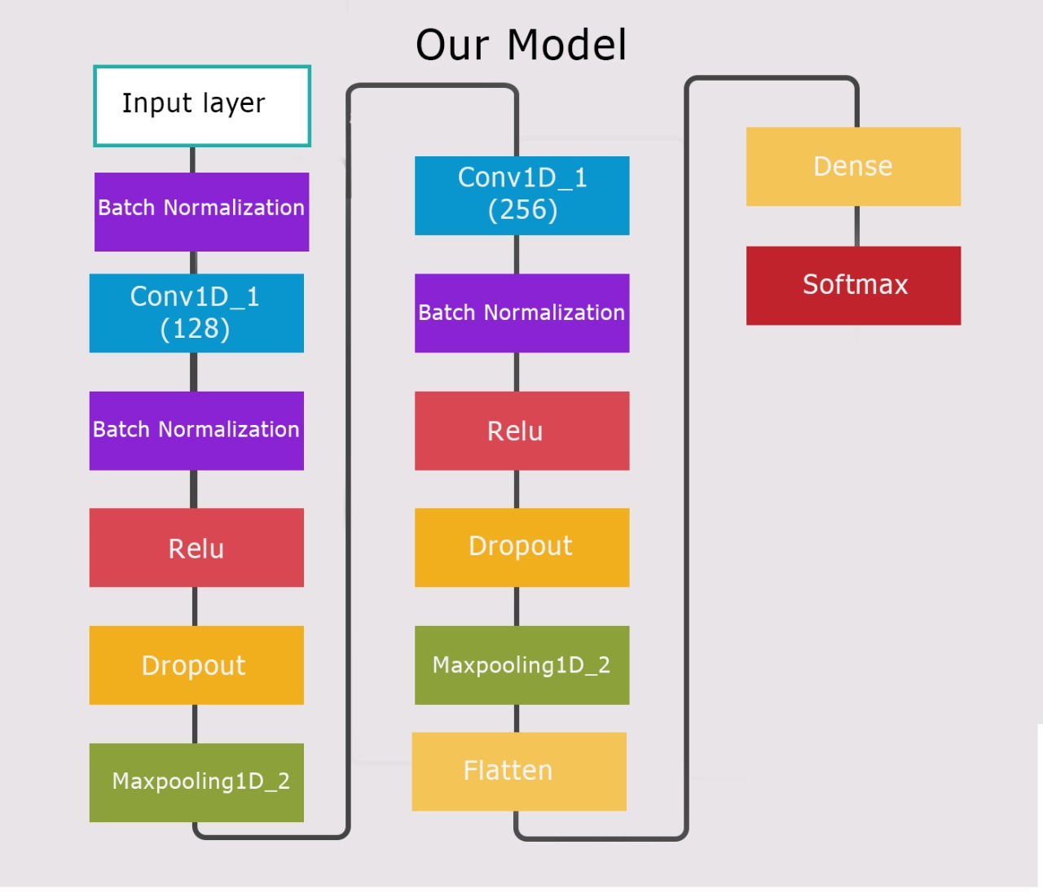
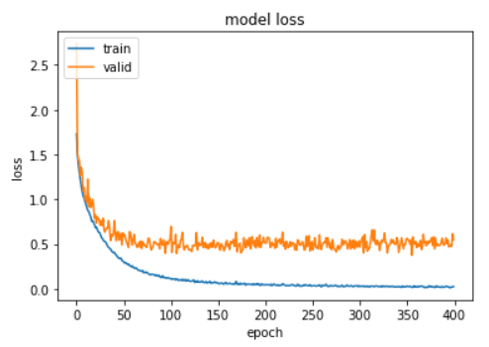
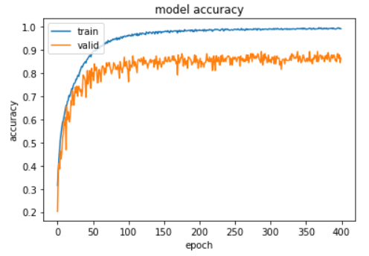
Model Improvements
we did augmentation on training set only with time_stretch and pitch_shift.
modified model by adding 3 batch normalization layers,the first one after input layer, the second one after the first Conv layer and the last one after the second conv layer, changing dropout rate 0.1 in the first conv layer and 0.3 in the second conv layer, change kernel size to 12 and remove 2 dense layer from original model.
Achieved 86.47% on RAVDESS dataset and 75.00% on SAVEE dataset.

Slide 12
Final Results (Improved)

Slide 13
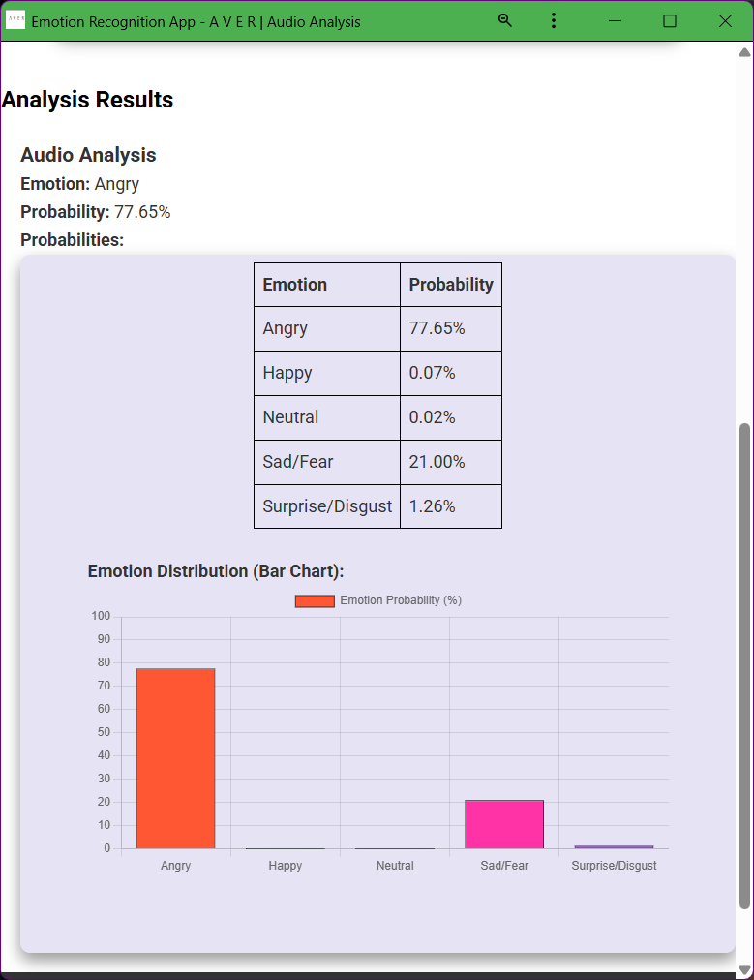
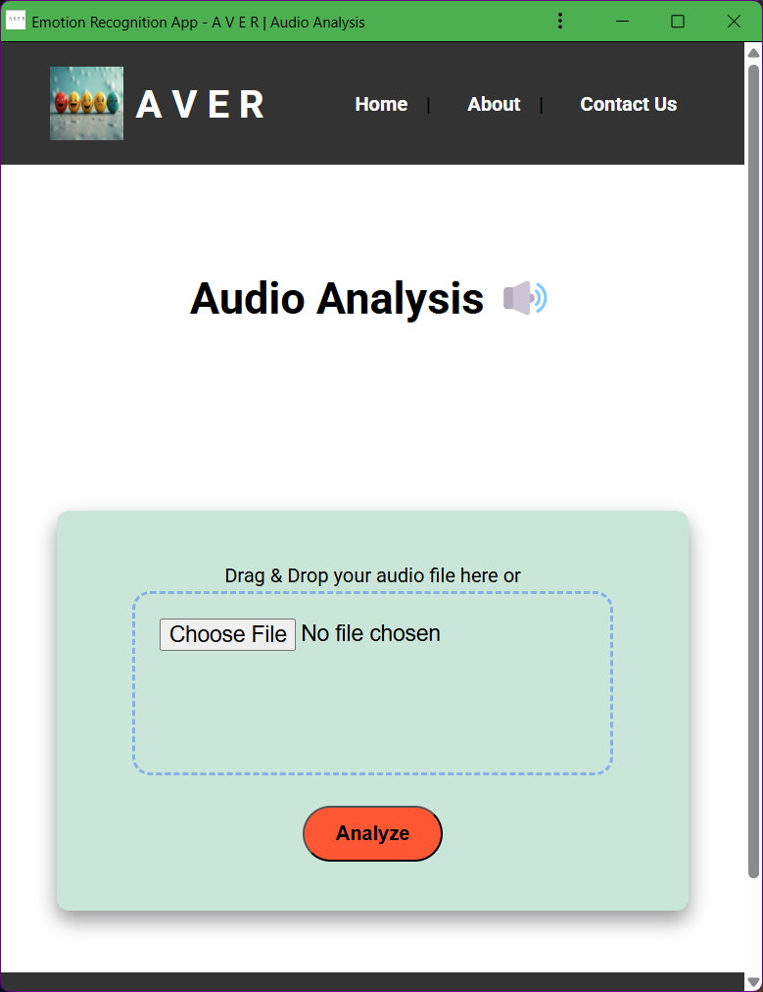
Input and Results

Slide 14
Phase 2
Video
In this phase, raw video data undergoes multiple preprocessing steps to prepare it for emotion recognition tasks. These methods ensure consistency, reduce noise, and focus on relevant features, improving model accuracy.
Label Videos by Emotion
Assign each video an emotion label (e.g., Happy, Sad).
Extract Frames & Label
Split videos into frames; each frame inherits the video’s label.
Facial Landmark Detection & Cropping
Detect key facial landmarks; crop frames to focus on the face.
Resize Frames
Standardize all frames to 64x64 pixels.
Normalize Frames
Scale pixel values (e.g., 0 to 1) to improve model performance.
One-Hot Encode Labels
Convert emotion labels into one-hot encoded vectors for classification.

Slide 15
Dataset Splitting Strategy
Splitting Strategies Used
First Split: ➔ 80% Training ➔ 20% Testing ➔ Validation: 20% of Training Data
Improved Split: ➔ 90% Training ➔ 10% Testing ➔ Validation: 10% of Training Data
Why Data Splitting?
Ensures reliable model evaluation
Helps tune hyperparameters
Prevents overfitting
✅ Improved accuracy with 90/10 split!

Slide 16
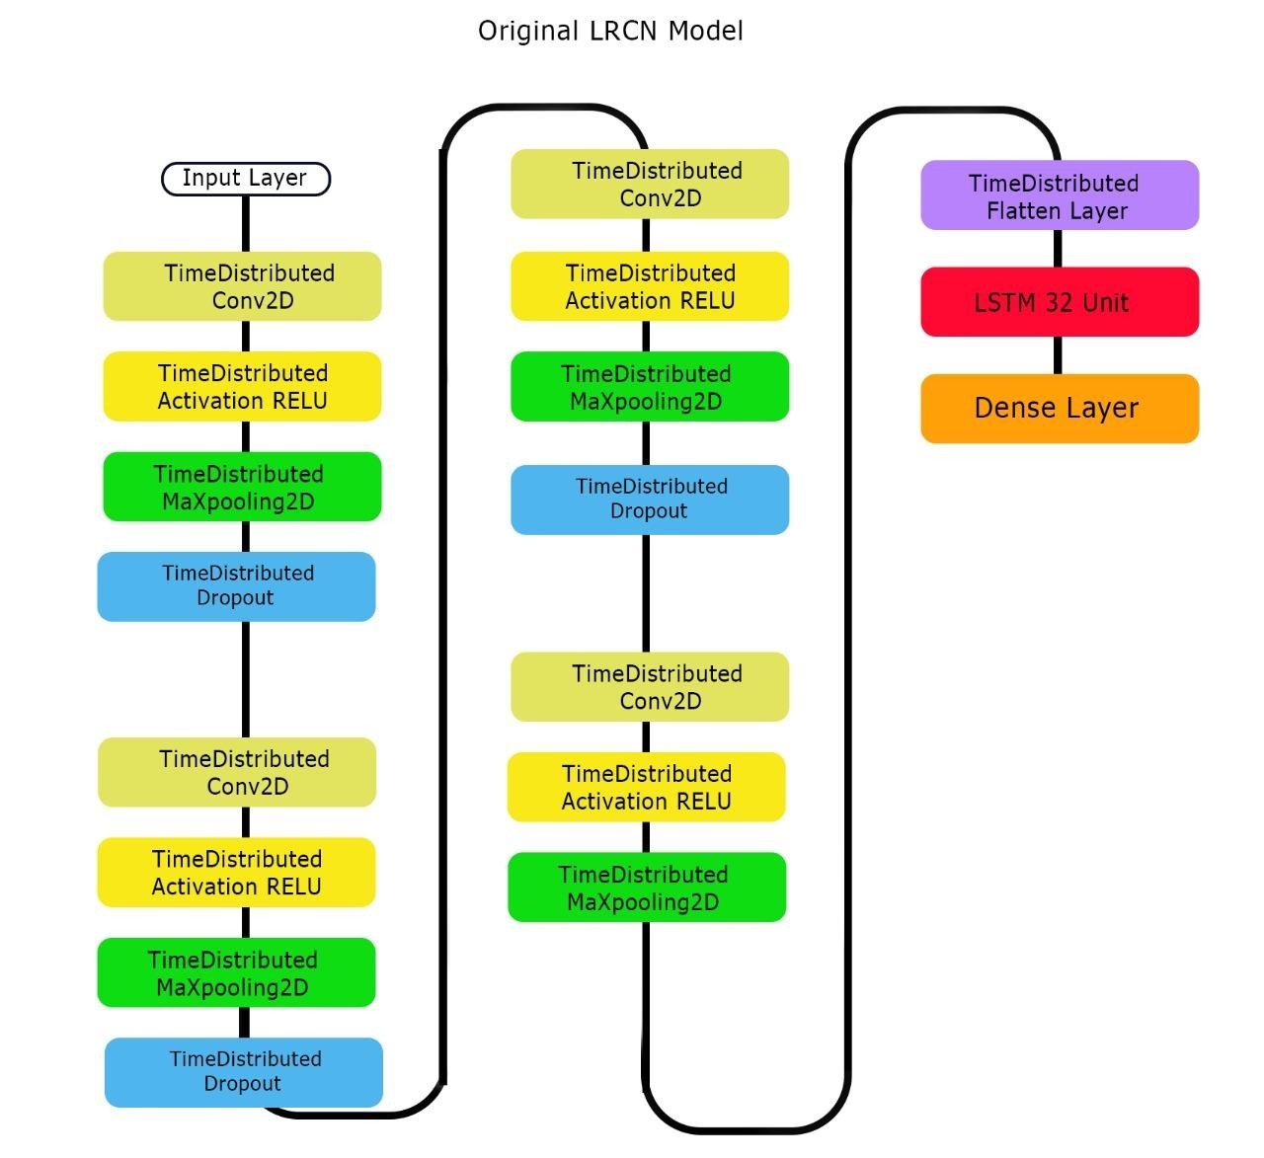
Original Model Details
Model : LRCN Model
Architecture:
3 Convolutional Layers
64 LSTM Units
Fully Connected Layers
Dataset:
RAVDESS
SAVEE
Performance:
RAVDESS: 80.67% ± 2.18%
SAVEE: 87% ± 2.78%
Issues:
Overfitting
Moderate accuracy
No batch normalization

Slide 17
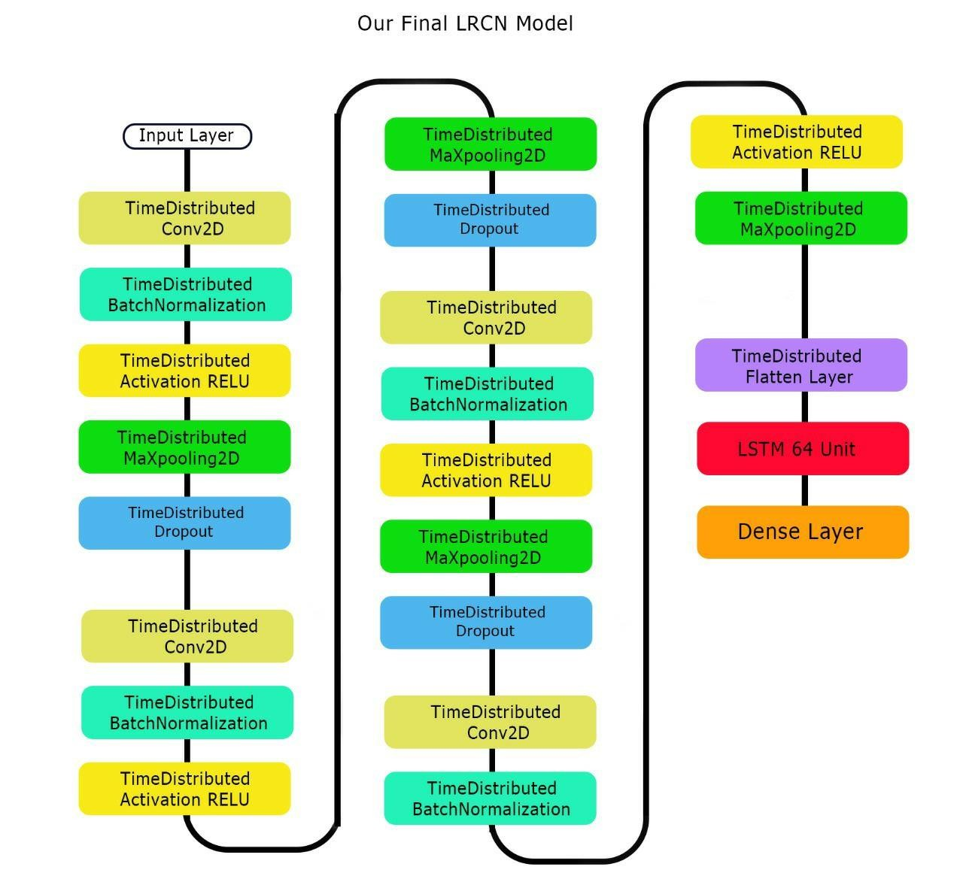
Model Improvements
What Was Improved?
✅ Optimized CNN Layers
Added extra conv layers
Better feature extraction ✅ Fine-tuned LSTM Units
Increased from X units to Y units (if you have specifics) ✅ Dropout & Regularization
Added dropout layers to prevent overfitting ✅ Data Augmentation & Preprocessing
Normalization
Resizing frames ✅ Optimized Learning Rate & Epochs
Fine-tuned learning rate schedule ✅ Loss Function
Cross-Entropy with class balancing (if you did this)

Slide 18
Final Results
(Improved LRCN)
Dataset | Baseline LRCN | Improved LRCN
RAVDESS | ~93% | 96.62%
SAVEE | ~95% | 97.22%
Key Takeaways:
Stable, accurate, and efficient

Slide 19
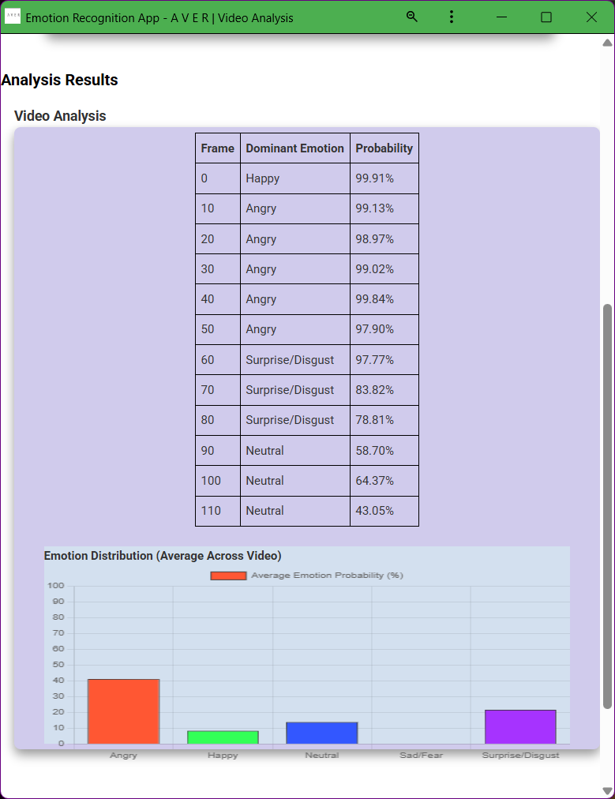
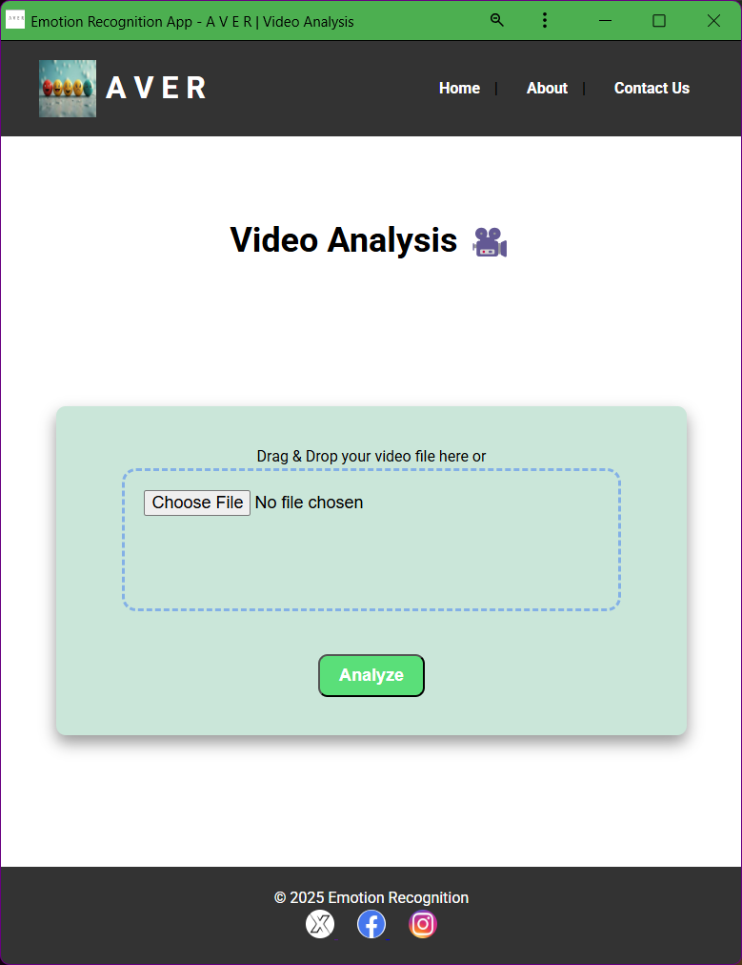
Input and Results

Slide 20
Combined analysis Multi-modal Emotion Recognition
🔸 Process Overview:
Input: Raw video from datasets (RAVDESS / SAVEE)
Separation:
Audio Track extracted and sent to the Audio Model
Video Frames extracted and sent to the Video Model
🔸 Video Stream Processing:
✅ Extract frames from the video
✅ Process frames using the Improved LRCN Model
🔸 Audio Stream Processing:
✅ Extract audio from the video
✅ Perform preprocessing (optional: noise reduction, feature extraction like MFCCs)
✅ Send audio to the Audio Model
✅ Outputs: Emotion predictions based on vocal features
🔸 End Results:
✔️ Separate emotion classification outputs from:
Video model (facial emotions)

Slide 21
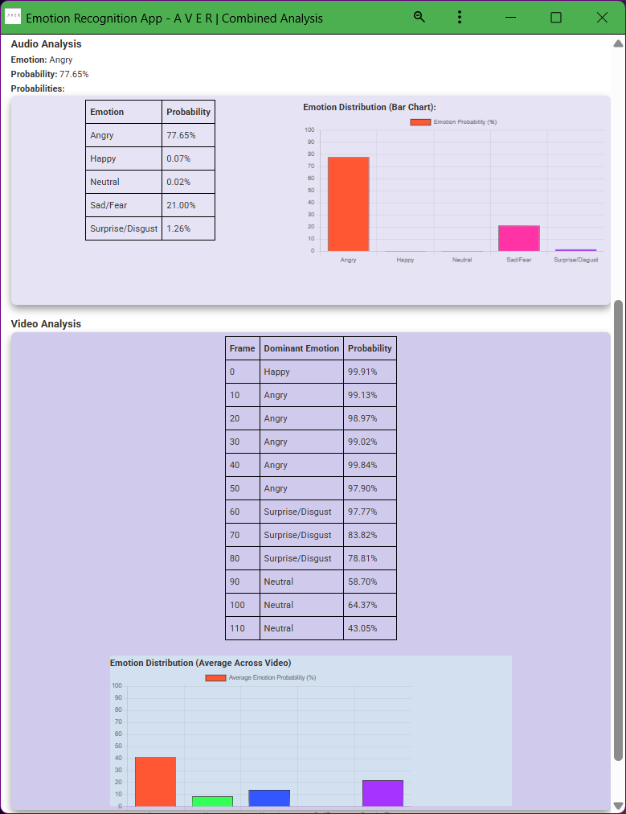
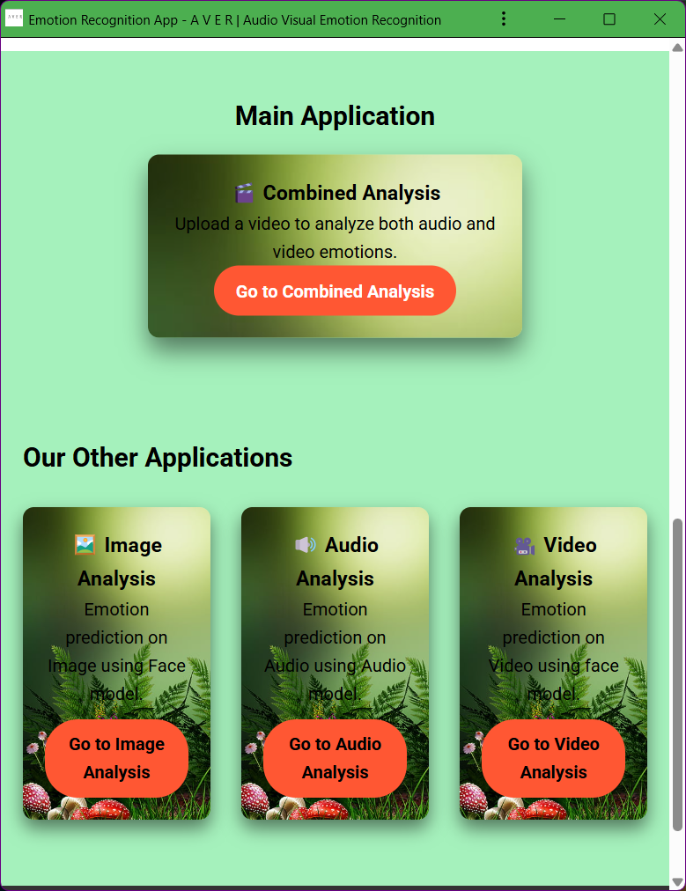
Input and Results

Slide 22
CONCLUSION AND FUTURE WORK
Project Summary
Our system processes audio and video separately to detect emotions.
Audio Phase:
Features extracted using MFCC, outperforming Mel Spectrogram.
Improved CNN models raised accuracy:
From 70.38% → 87% on RAVDESS (6 emotions).
From 61.46% → 83.3% on SAVEE.
Video Phase:
Frames extracted from videos and classified using ConvLSTM and LRCN.
ConvLSTM improved from 74.8% → 84.54% (RAVDESS).
LRCN improved from 80.67% → 93.27% (RAVDESS).
Future Work
✅ Deploy in online admissions/interviews to assess candidates’ emotions. ✅ Apply to e-learning for real-time student feedback. ✅ Use in marketing for customer emotion analysis. ✅ Implement in automotive for driver drowsiness detection. ✅ Enhance models via transfer learning & larger datasets.

Slide 23
References
G. Mendels, Audio Analysis & Machine Learning, Towards Data Science, 2019.
L. T. Alberto Albiol, Video Preprocessing for Emotion Recognition, IEEE Symposium, 2014.
N. Ellarby Sánchez, Emotion Detection through Audio and Video, Final Thesis, 2021.
A. H. Lu et al., Audio Representation, Springer US, 2009.
Wikipedia, Spectrogram, 2022.
A. Bajaj, Performance Metrics in ML, Neptune AI, 2022.
S. Livingstone & F. Russo, RAVDESS Dataset, PLoS One, 2018.
P. Jackson & S. Haq, SAVEE Dataset, 2014.
J. A. R. & A. M. Badshah, Speech Emotion Recognition with CNN, PlatCon, 2017.
B. Puterka & J. Kacur, Time-based SER, IEEE, 2018.
N. E. B. Hajarolasvadi et al., Video-based Facial Emotion Recognition, 2021.
S. Zhang et al., Hybrid Deep Model for AV Emotion Recognition, IEEE, 2017.
GitHub Repos:
Transformer CNN Emotion Recognition, Zenkov, 2020.
Speech Emotion Classification, Kosta-jo, 2021.
MathWorks, Deep Learning Preprocessing, [Online].

Slide 24
Thank you

